Slide 1
Task 14 - ML MODELS SUMMARY

Slide 2
IMPROVED MODELS
Clustering: kmeans (Task 9 –Samwel Jane, Task 10 – Dave Bunten*)
Regression: Random Forest (Task 11: Joseph)
Auto-ML: IBM Watson Studio (Task 11: Joseph)
Sentiment Analysis*:
Linear Distant Analysis (LDA)
1

Slide 3
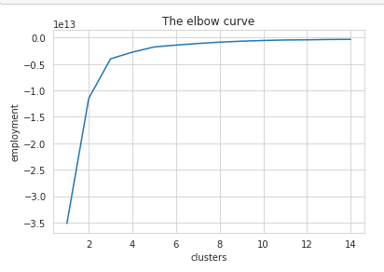
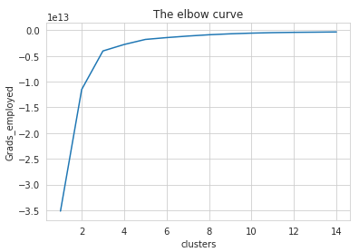
TASK – 9: KMEANS CLUSTERING
Model Descriptions
K-Means clustering is an unsupervised learning algorithm that, as the name hints, finds a fixed number (k) of clusters in a set of data. A cluster is a group of data points that are grouped together due to similarities in their features [1].
Pre-processing and model development:
There were two different clustering models for earning and employment data
The missing values were filled with mode of the available data.
Three clusters were utilized for employment data
On both graphs, the elbow curve is observed to be at cluster number 3. Thus, our n_clusters=3
1. Employment Data
2
[1] https://blog.easysol.net/machine-learning-algorithms-3/

Slide 4
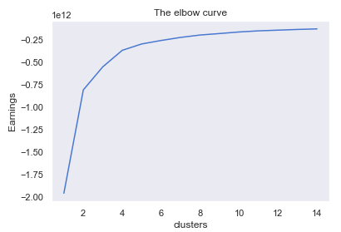
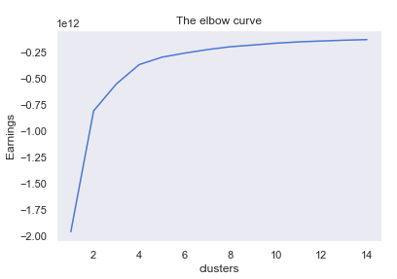
TASK – 9: KMEANS CLUSTERING
Model Descriptions
Both elbows from tuned and non tuned parameters suggests the number of clusters as 4(k=4)
3

Slide 5
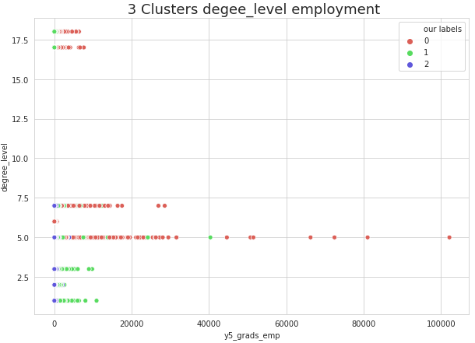
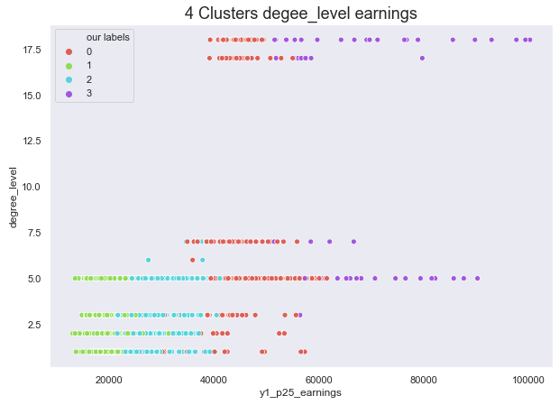
TASK – 9: KMEANS CLUSTERING
Model Results and Performance
1. Employment level clustering
2. Degree level clustering
There more clustering for earnings and others datasets. But performance seems to be poor. They are considering random forest, decision trees for classification.
4

Slide 6
TASK – 11: RANDOM Forest Model
Model Descriptions
Random forests or random decision forests are an ensemble learning method for classification, regression and other tasks that operate by constructing a multitude of decision trees at training time and outputting the class that is the mode of the classes (classification) or mean prediction (regression) of the individual trees [2].
Pre-processing and model development:
The missing values were filled with mean of the available data.
The datasets used in training the model consist of three countries(OECD countries in North America: U.S.A, Canada and Mexico)
The features of the dataset were standardized using standardscaler().
The data is splitted into training and test data at a percentage split of 0.75 to 0.25 respectively.
The number of estimators used is 300 and the random state of the model is 5.
5
[2] https://en.wikipedia.org/wiki/Random_forest

Slide 7
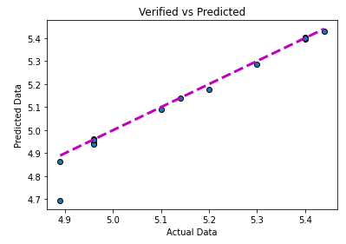
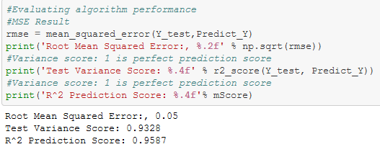
TASK – 11: Auto ML(IBM Watson)
Model Results and Performance
a. Results of Random Forest
b. Performance of Random Forest
The predicted data and the actual/verified data are compared with the aid of a regressor line. The line tries to divide through the data points(predicted and actual data) by passing through the best path.
6

Slide 8
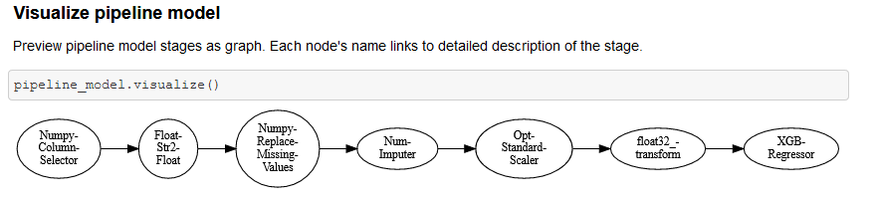
TASK – 11: Auto ML with IBM Watson
Model Descriptions
Automated machine learning (AutoML) is the process of automating the process of applying machine learning to real-world problems[3]. There are several automated machine learning models such Amazon sage maker, Cloud AutoML, IBM Watson, etc.
Pre-processing and model development:
The missing values were already filled with mean of the available data before uploading to Watson ML.
The datasets used in training the model consist of three countries(OECD countries in North America: U.S.A, Canada and Mexico)
The data is splitted into training and test data at a percentage split of 0.75 to 0.25 respectively.
7
[2]https://en.wikipedia.org/wiki/Automated_machine_learning

Slide 9
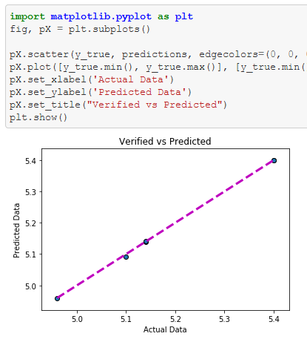
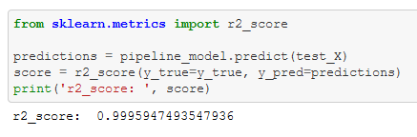
TASK – 11: Auto ML(IBM Watson)
Model Results and Performance
b. Performance of IBM Watson’s model
a. Result of IBM Watson’s model
As seen from the chart and the performance metrics above, IBM Watson ML has a better result as compared to manually built random forest regressor. IBM Watson built a pipeline for several models, gradient boost happens to be the best performing among others as it was rank first by IBM Watson.
8

Slide 10
Conclusion
What to expect?
Training of members.
Reports
Recommended Models and Shortcomings
9

Slide 11
THANK You!

